Slide 1







Membership Details

Slide 2



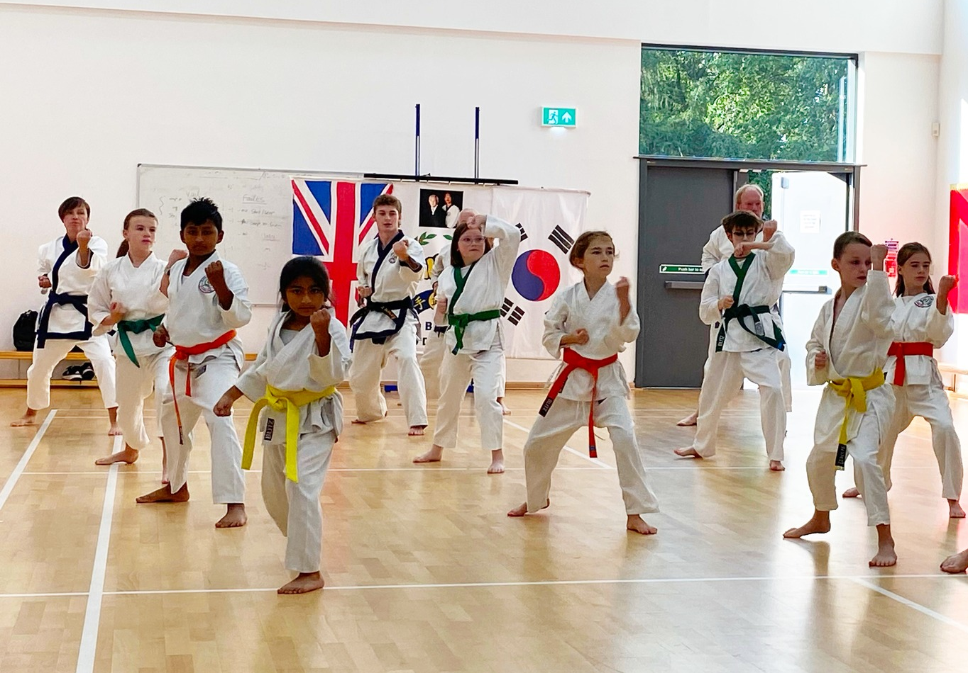



Location
Higher Lane,
Rainford,
St. Helens,
WA11 8NY

Slide 3
Club Class Times Explained
Lesson structure:
Tuesdays and Thursdays at Rainford high:
7:00pm to 8:00pm (Beginners)
White belts(10th Geup) to Orange 1 tag (7th Geup)
8:05pm to 8:50pm (Advanced)
Green belts (6th Geup) and above.

Slide 4


Club Fees Explained
We base the fees on 2 x 1hour beginner’s (Basic) sessions per week.
The advanced classes are not charged for and are to allow advanced members to focus on their syllabus and development.
The cost for a member per month by Direct Debit is £40.
This covers for 8 lessons per month, which works out at £5 per session.
As this is already a good price, members who can only attended once a week are discounted £30 per month.

Slide 5




Family Discounts
Families training twice a week:
1st Member= £40
2 Family Members= £60
3 Family Members=£80
4th Family member is free
Families Training once a week:
1st Member= £35
2 family Members= £55
3 family Members = £65
4th member free

Slide 6


Federation Fees to be paid once a year
You will need to join the federation as Soo Bahk Do is an internationally recognised Martial Arts Federation.
The cost per member is £35 per year.
Families can pay this one member at time over the 1st 6 weeks to make it easier.
This payment goes directly to the federation.
There are opportunities to take part in seminars and train all over the world once you have joined.

Slide 7


Internationally Recognised Gradings Promotions
4 times a year there is an opportunity to attend a Grading if your instructor has assessed you as ready.
These gradings are carried out with A Soo Bahk Do Master as the examiner and cost a learner £25.
There are discounts for families to make this affordable.
Gradings are not compulsory, but club members usually want to advance.
Grading fees:
1st family Member £25
£10 extra for each additional family member.

Slide 8
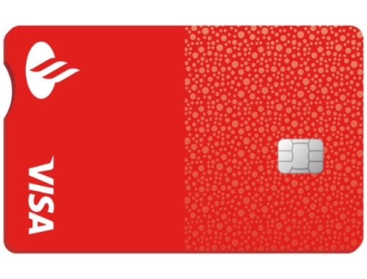


Monthly subscription Payment
Details
Bank: Barclays
Account holder: Miles Tarplee
Sort code: 09-01-30
Account No: 03516070
Account holders:
Miles & Reece Tarplee
Sort code: 09-01-30
Account No: 03516070

