Slide 1


Little Tigers
Helpers and Trainee
Instructor
Guidance

Slide 2
Introduction
You have been offered this position as a helper or trainee instructor, as you have displayed the following skills required in the Do Jang.
Humility
Kindness
Concentration
Discipline
Control of power
Honesty.
Leadership
Teaching is a useful life skill and will help you in your future.

Slide 3
Introduction
We want this to be a positive experience and journey of development for you, so please always remember the following:
Enjoy the experience and let us know if you have any concerns.
Don’t feel pressured to make adult or senior decisions, as we are here to do that for you.
Always ask if you are not sure about anything. No questions are silly questions.
Remember that children don’t always listen and are having to learn what’s right and wrong, just like you did.
Let the senior instructor deal with behaviour issues and remember that the parent is usually watching their young child and you.
These following slides will help you to make this experience positive for you and your leaners.

Slide 4
Think safety first
Never demonstrate a technique on a student unless it is at very slow speed and controlled, as students may move into the move and hurt themselves.
Use another member of the group with experience and explain what you will be demonstrating to them checking that they understand..
Do Not invent new activities in lesson!
New ideas will be looked at, but need to be included in our risk assessments before kids try them out.
Look out for possible issues with children not getting on.
Help your instructor to manage the children when his, or her back is turned.
Always talk to us if you are concerned about anything or need help as you are important to us too.
Help the instructor to ensure kids do not leave the room unsupervised.

Slide 5
How to teach martial arts to children
You can help improve their:
Fitness
Discipline
Confidence
And,
Be a positive role model in their lives.

Slide 6
Know what to expect when teaching children
Chaos!!
Make sure you have the rules and structure to control the room.
Use strategies like:
Making kids stand to attention, or may be..
Sit down.

Slide 7
Teaching martial arts to kids
kids' attention spans are short
Avoid long periods where students watch demonstrations

Slide 8
Remember you’re dealing with little bodies
Children are the most important thing in someone's life.
We want to help look after and keep these children safe.
We want to build their confidence and life skills
We need to be a positive influence to back up their families’ own values.
Stick to what we discuss and, the way we teach unless previously agreed.

Slide 9
Group drills.
Group drills help to boost confidence, develop skills, and ensure the less confident don’t feel singled out.
If a lesson isn’t working, introduce a running around activity to break the cycle.

Slide 10
Kids have high energy in short, sharp bursts
Kids have high energy in short, sharp bursts.
Smart instructors use this as a gift.
Use the time to make as much nois and expend as much energy as possible.
The parents will thank you for it too, when you deliver their child ready for Bed.

Slide 11
Young bodies are also super flexible
Young bodies are also super flexible, so need a shorter stretching time than adults.
Training at a young age offers huge benefits – a young body retains its elasticity – they’ll thank you for it in later life!
Despite this, we need to always carry out the warm-up.
Warm-ups should involve more loosening up rather than muscle building as their little bodies are still developing.

Slide 12
Kids need positive reinforcement at every step of the way
Kids need positive reinforcement at every step of the way.
Yes, you’ll have to tell them the same thing again and again.
But they showed up, and they’re giving it their all.
That deserves your applause – and patience.

Slide 13
It’s crucial to keep your lessons as varied and lively as possible.
It’s crucial to keep your lessons as varied and lively as possible.
You’re dealing with short attention spans.
Keep activities short and look for ways to interact with the kids that might be waiting to join in or start the assault cause.
Reinforce similar techniques and routines to establish them as habits and our club traditions.
Again, applaud good behaviour or actions that complement our values

Slide 14
Make it fun
This is a fun learning environment.
This isn’t school!
We need to keep our classes as fun and interesting as possible.
Remember! Kids do have a say in their preferred activities… “It’s boring!” is not the feedback we want.

Slide 15
Humour
Be the humorous, relatable, and engaging instructor your Little Tigers warriors want to hang with.

Slide 16
Give the kids a chance to show their bravery
Helping with warm-ups
Counting in drills
Asking questions
Give positive responses even if they haven’t answered correctly.

Slide 17
Build their confidence

Slide 18
Make sure you remember!
We want this to be a positive experience for both the children and parents / spectators.
Children can be frustrating, and difficult.
Let the senior instructor deal with issues.
Don’t try to resolve problems, as you are there to help and have fun.
Report any bad behaviour to the senior instructor immediately so it can be dealt with..
Respond immediately to positive actions, especially if the child struggles to concentrate, or stick to the lesson activities.
Remember, the Senior instructor in charge, needs to be notified, and be allowed to deal with any behaviour, parental concerns, or issues that arise.
It’s not your responsibility.

Slide 19


Slide 20

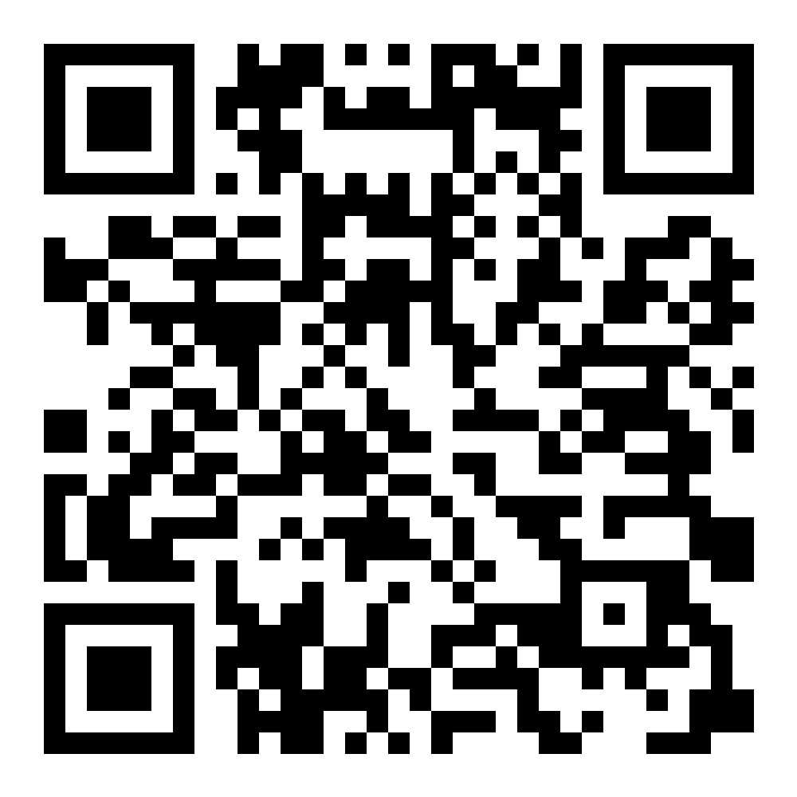
Please press on the link, or image to complete the following assessment quiz.
Screen shot and return your pass mark to your instructor.
https://quizizz.com/join?gc=86582265

